Slide 1


Automated Stress Testing and Monitoring on Virtualized & Containerized Environment

Slide 2


Overview
Introduction
04
Virtual Machine Setup
05
Ansible Configuration
06
Prometheus Configuration
08
Monitoring Setup
10
Python Script
13
Version Control and CI/CD with Jenkins
14
Email Notifications and Alerting
20

Slide 3
Overview
Logging Implementation for the Python Script
23
Log Analysis & AI Automated Suggestions
24
Containerization & Orchestration
27
Conclusion and Future Enhancements
28

Slide 4

Introduction
Objective:
To set up an automated environment for system stress testing and monitoring across cloned VMs.
Key Components:
Virtual machines, CI/CD pipeline, configuration management, containerization, monitoring, and alerting system, log analysis, AI automated suggestions.

Slide 5

Virtual Machine Setup
Goal: Clone and configure three virtual machines with distinct roles:
vm_0: Prometheus, Alert Manager and Grafana for monitoring, alerting and visualization.
vm_1: Host for stress-testing script, Jenkins for CI/CD pipeline and exporters for metric collection.
vm_2: MySQL server for database stress testing.
OS: Compatible Linux distribution -CentOS9.

Slide 6
Ansible Automation:
Automated installation and configuration of required software (Prometheus, Grafana, MySQL, exporters, etc.) via Ansible node.
Configuration Management with Ansible
Playbooks:
Ensures software consistency across all VMs.
Benefits:
Reduced manual setup and faster configuration management.

Slide 7
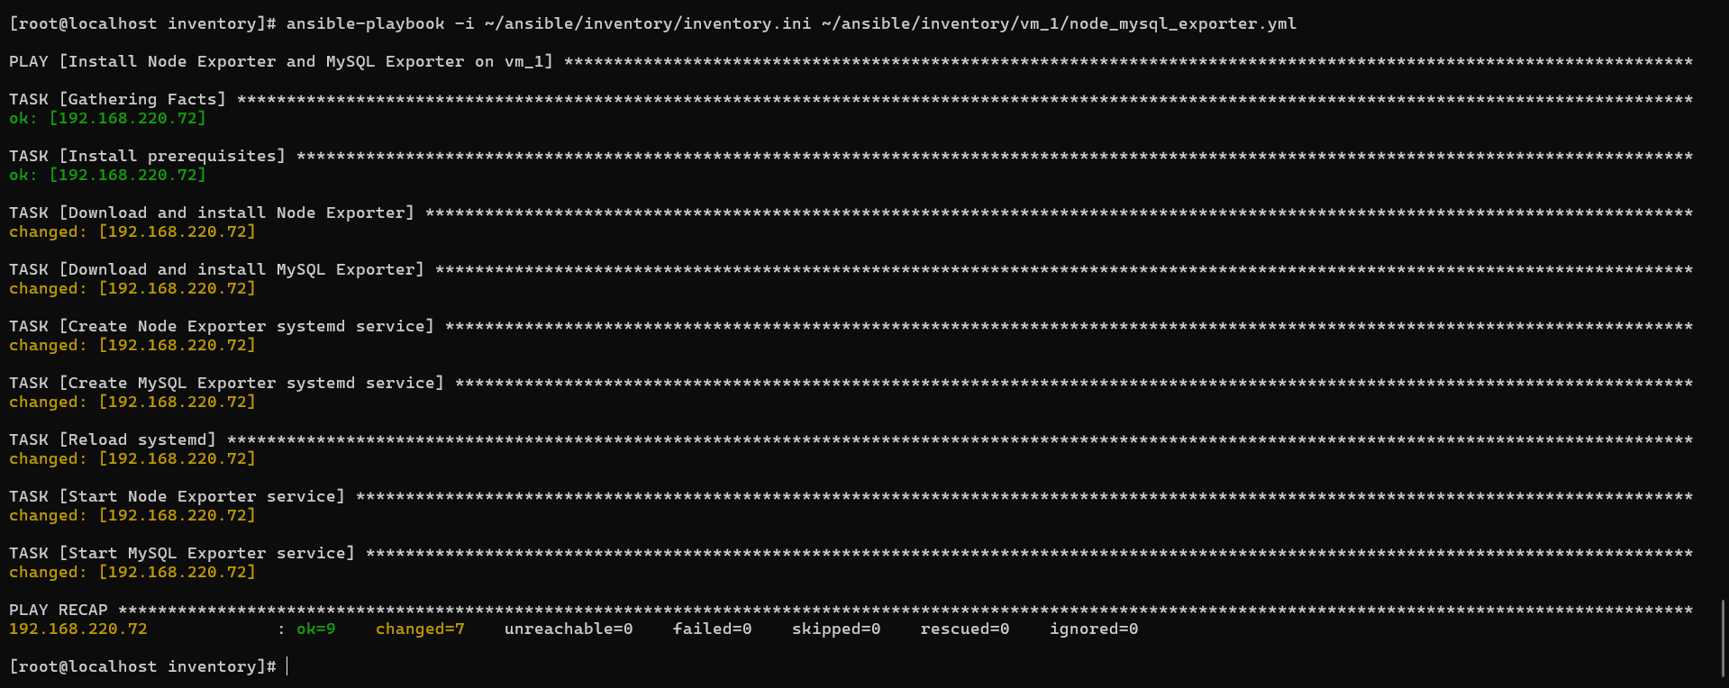
Ansible Execution

Slide 8
Configure Prometheus to Scrape Metrics from Node Exporter and MySQLD Exporter
Installed Prometheus on vm_0.
2. Installed Node Exporter on vm_1 to collect OS-level metrics.
3. Installed MySQLD Exporter on vm_1 to gather MySQL metrics from vm_2.
4. Editing the prometheus.yml file, adding the exporters under scrape_configs.
5. Restarted Prometheus with the updated configuration.

Slide 9
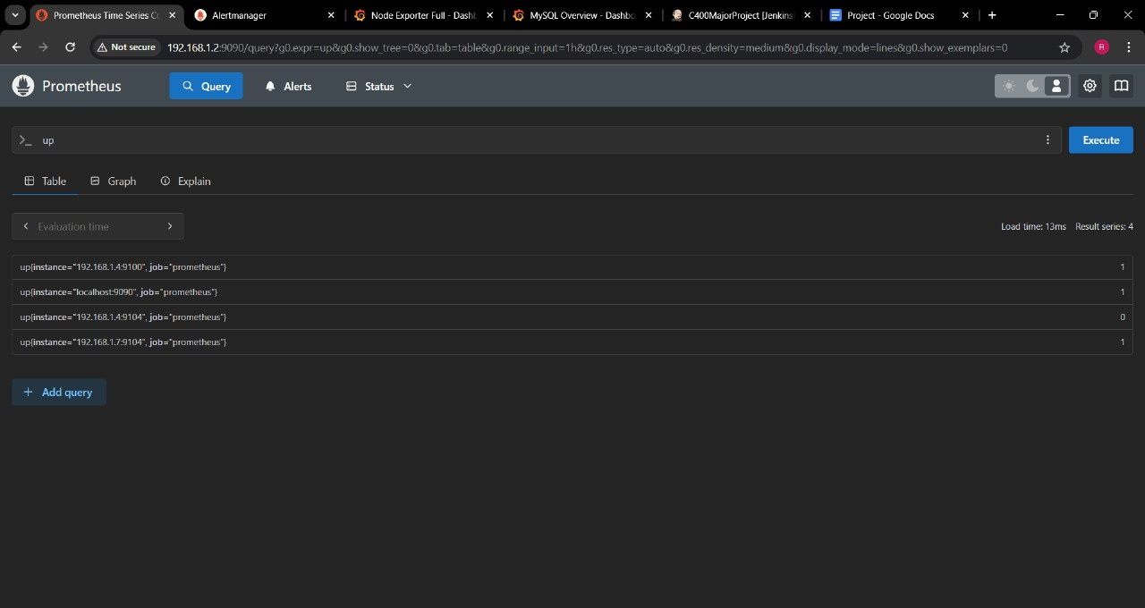
Prometheus Dashboard

Slide 10


Monitoring Setup (Prometheus & Grafana)
Prometheus on vm_0
Grafana on vm_0
Collects metrics from Node Exporter, MySQLD Exporter on vm_1
Visualizes real-time metrics and monitors the impact of stress tests.
Custom Grafana dashboards to track CPU, memory, disk, network usage, and MySQL performance.
Node exporter – dashboard code 1860
Mysql overview – dashboard code 7362

Slide 11
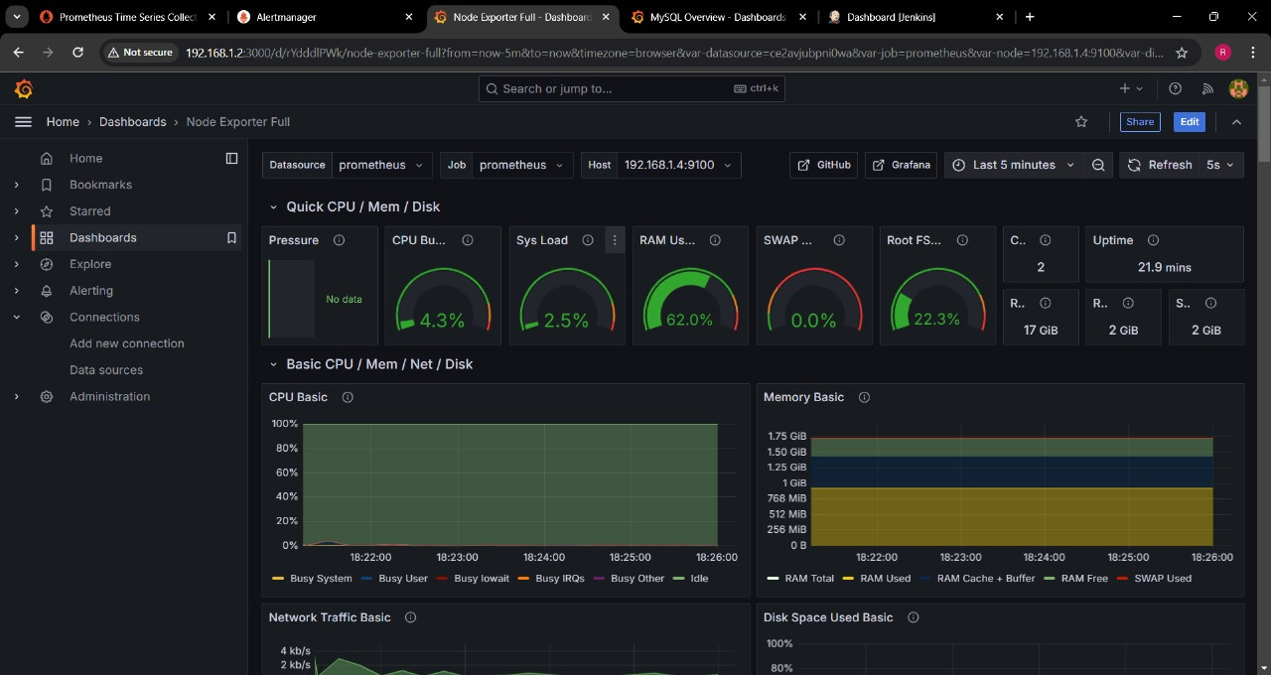
Node Exporter Dashboard

Slide 12
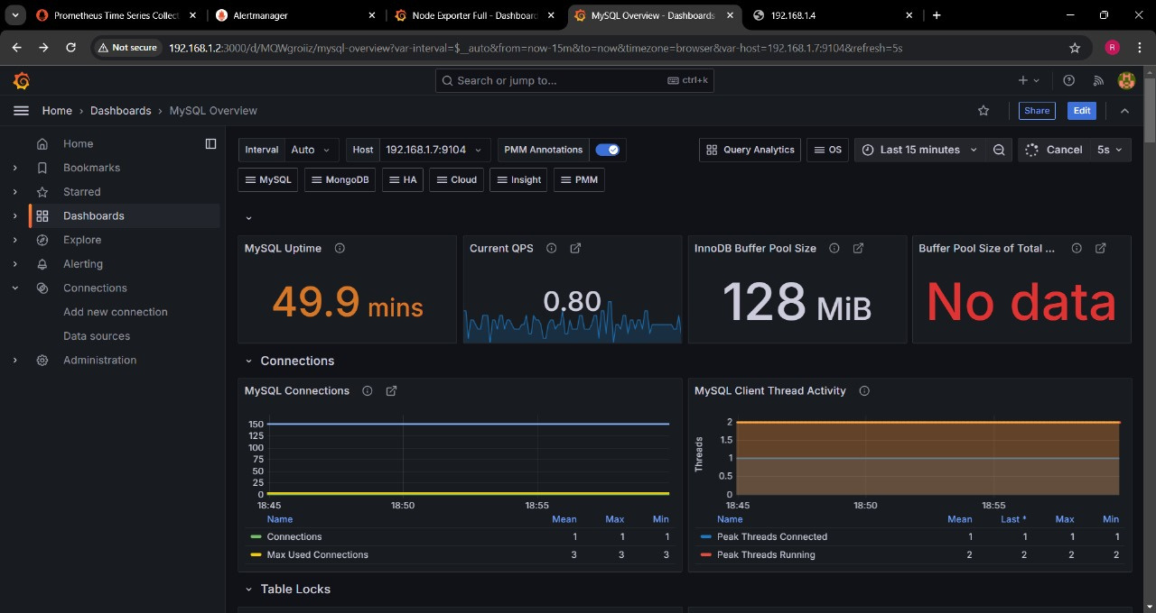
MySQL Dashboard

Slide 13
Python Script for Stress Testing
Purpose: Menu-driven Python script to initiate different types of stress tests on vm_1.
Menu Options:
Memory Stress Testing
Disk Stress Testing
Network Stress Testing
CPU Stress Testing
MySQL Stress Testing
Additional Setup on vm_2
Run iperf3 -s
Setup mysql-server
Create a database for testing
Create a user with permissions granted

Slide 14

Version Control and CI/CD with Jenkins and GitHub
Version Control
Pushing the script to GitHub.
Jenkins Setup
Configuring Jenkins on vm_1 and using ngrok for external webhook communication.
Building a Jenkins pipeline to automate cloning GitHub repository in the required virtual machine.

Slide 15
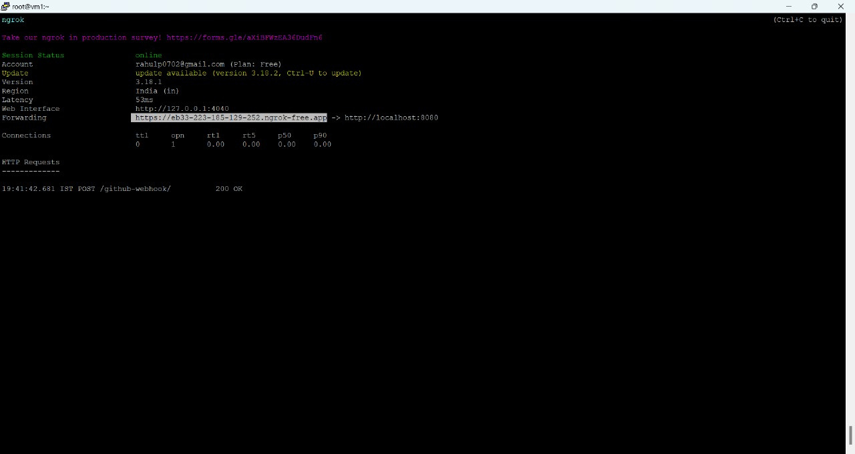
Ngrok for webhook communication

Slide 16
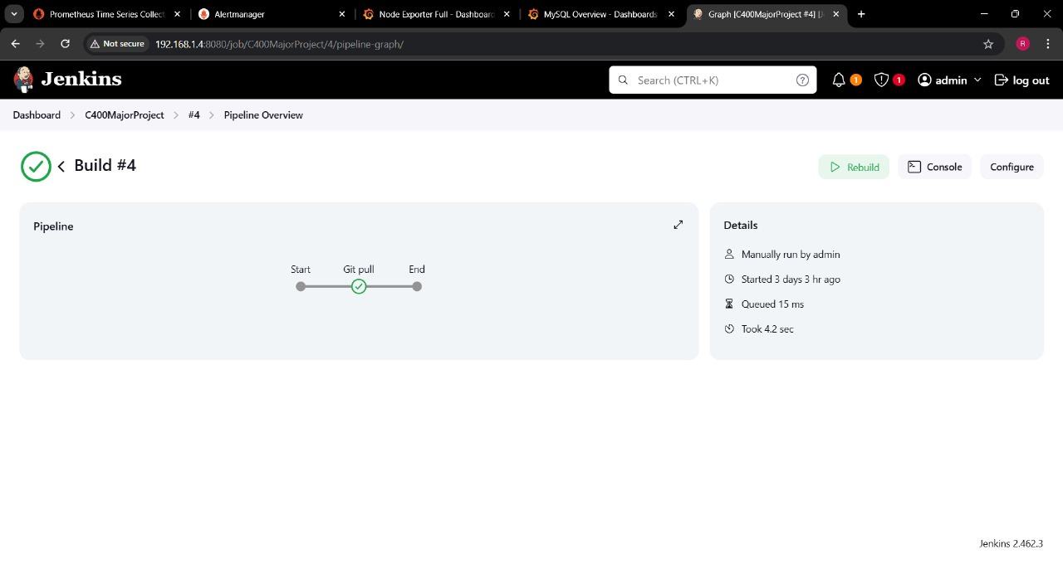
CI/CD Pipeline

Slide 17
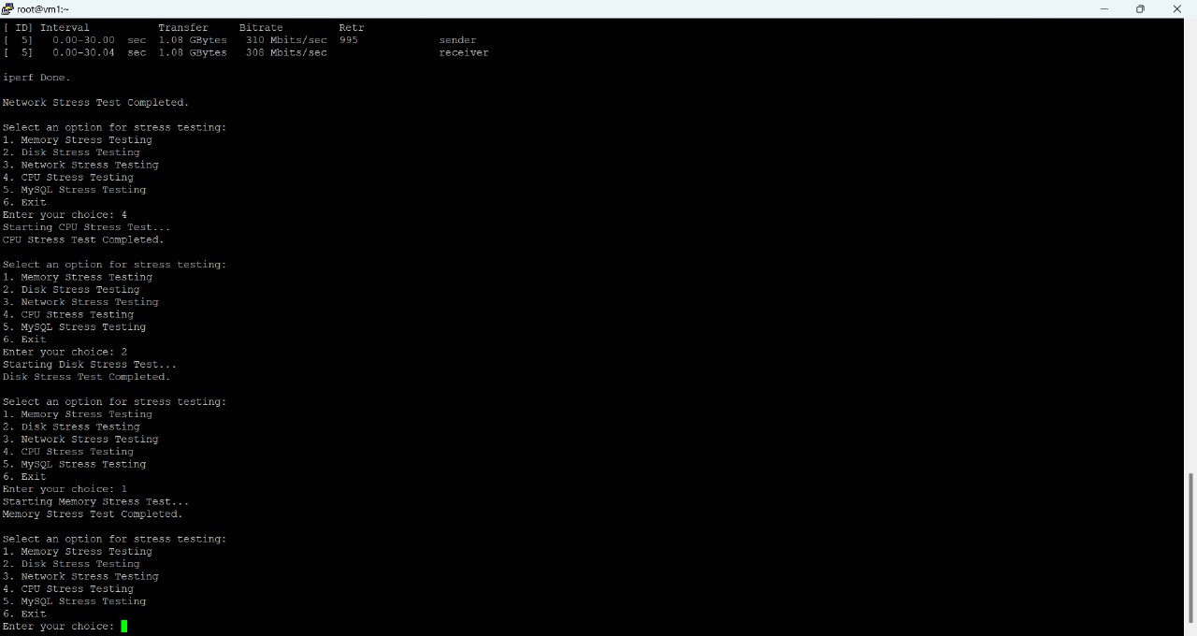
Python Script Execution

Slide 18


Threshold-based Email Notifications
Stress Threshold
EmailNotification
80% of resource usage across tests triggers alerts.
Configured email service (SMTP) sends alerts if usage exceeds 80%.
Goal: Ensure prompt response to potential system overloads.

Slide 19
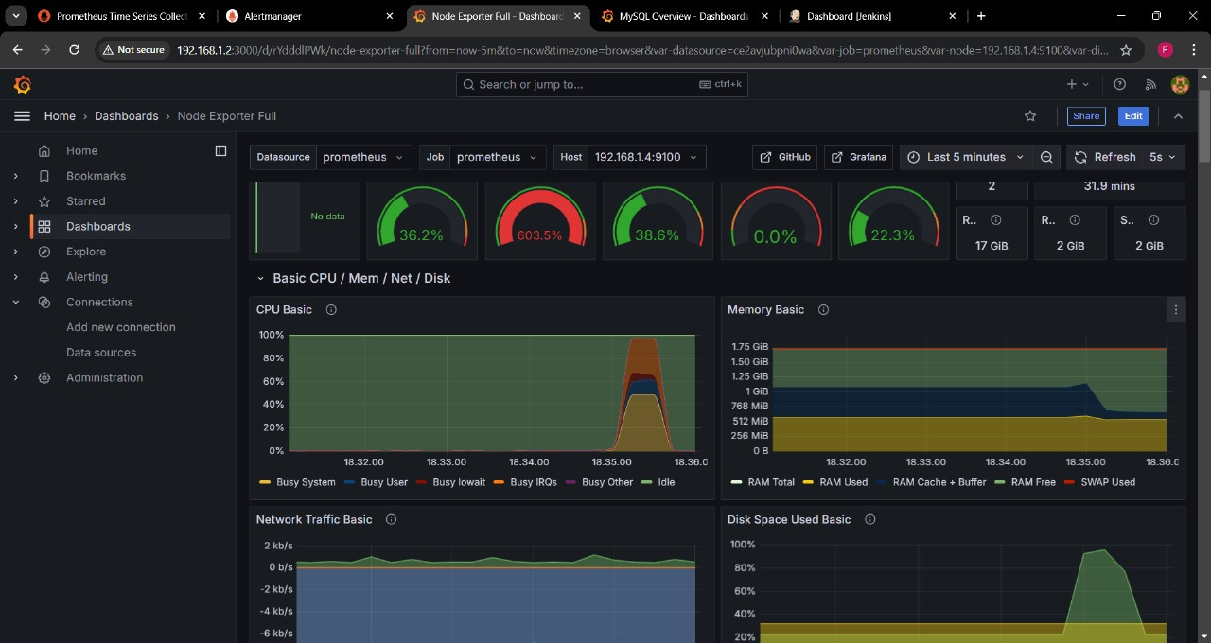
Node Exporter Dashboard during Stress Testing

Slide 20
Notification Integration:
Email alerts triggered via Alert Manager if stress test thresholds exceed 80%.
Email Notification & Alerting
Service Used:
SMTP for reliable email delivery.
Purpose:
Proactive alerting for efficient monitoring and incident response.

Slide 21
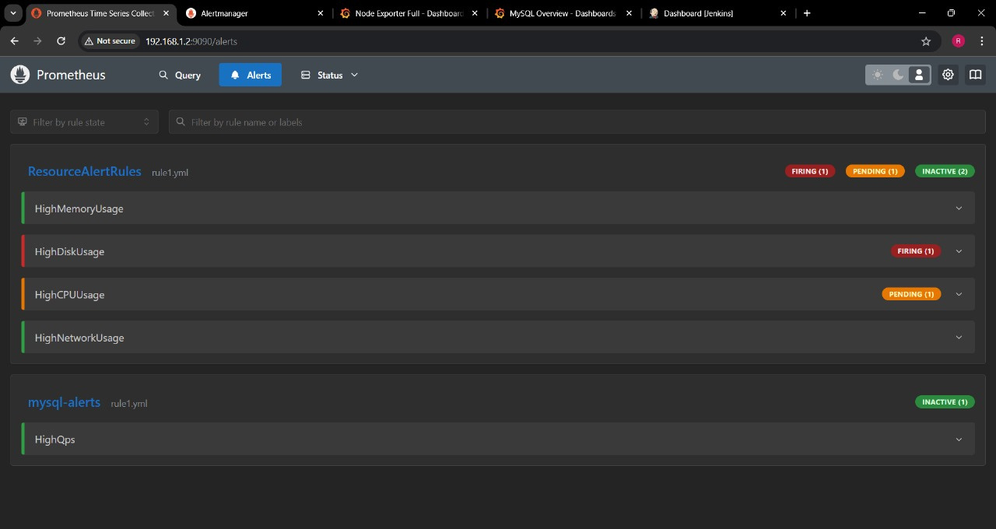
Prometheus Alert

Slide 22
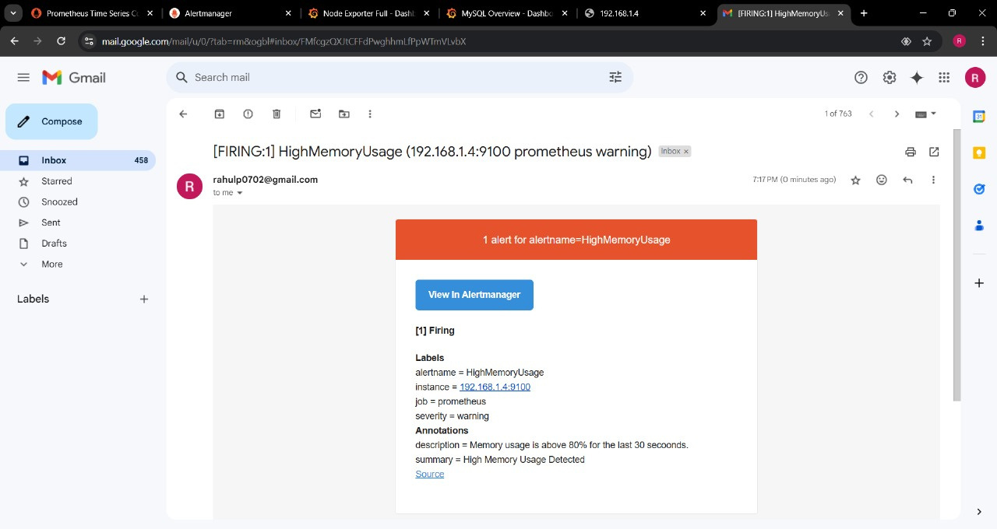
Email notification

Slide 23
Logging Implementation for the Python Script
1. Using Python's logging module to capture outputs and errors.
2. This script logs:
When each test starts and completes.
Current system metrics after each test.
3. The log file: stress_test.log stores information, capturing any issues or warnings as needed.

Slide 24


Log Analysis & Automated Suggestions
Goal:
Continuous improvement through actionable insights.
Log Analysis
Script logs are periodically sent to Gemini API for analysis.
Automated Feedback:
API provides insights and recommendations based on log data.
WhatsApp Integration:
Feedback sent to WhatsApp via Twilio API for easy access to suggestions.

Slide 25
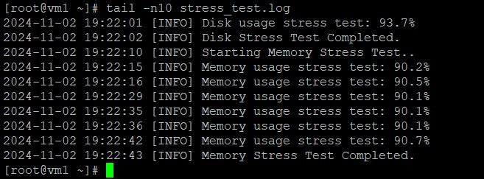
Log File

Slide 26
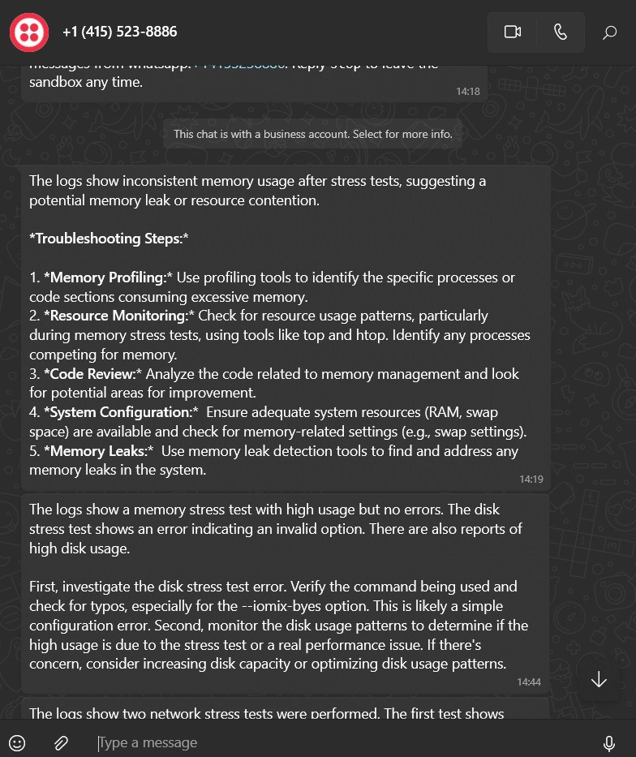
Feedback on WhatsApp

Slide 27



Containerization and Orchestration
Containerization
Kubernetes Deployment
Python script is containerized with Docker for portability.
Kubernetes used for deploying and managing the Docker container.
Kubernetes Manifests
YAML files for deployment configuration and scaling.

Slide 28
Conclusion and Future Enhancements
Conclusion:
Successfully established an automated environment for robust stress testing, monitoring, alerting, and AI generated automated feedback.
Future Enhancements:
Expand testing parameters, integrate with additional monitoring tools, or explore machine learning models for advanced log analysis.

Slide 29
References
https://www.twilio.com/docs/whatsapp/quickstart/python
https://sematext.com/blog/python-logging/
https://ai.google.dev/gemini-api/docs/quickstart?lang=python
https://medium.com/@chachia.mohamed/stress-testing-in-centos-using-sysbench-and-stress-commands-2c4530122c45
https://docs.google.com/document/d/1XZRF9xK_Lmwz--lN3o8fxyEbYWwC6ReQB9viUleXDmY/edit?usp=sharing

Slide 30

THANK YOU!

